Slide 1
Concepts covered
Static LAN [SLAN]
Concept of VLAN
VSAN
VSAN and benefits

Slide 2
Static LAN
A LAN is a computer network that consists of access points, cables, routers, and switches that enable devices to connect to web servers and internal servers within a single building, campus, or home network, and to other LANs.
A router assigns IP addresses to each device on the network and facilitates a shared Internet connection between all the connected devices. A network switch connects to the router and facilitates communication between connected devices, but does not handle Local Area Network IP configuration or sharing Internet connections. Switches are ideal tools for increasing the number of LAN ports available on the network.

Slide 3
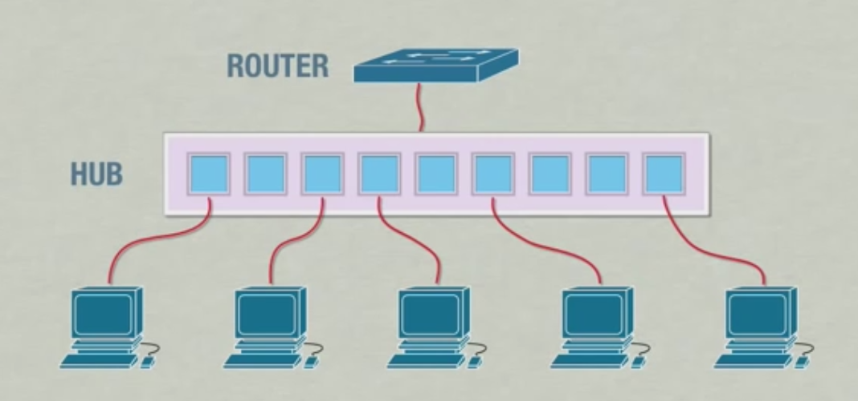
Flow of packets in Static LAN

Slide 13
Collision Domain
A collision domain is, as the name implies, the part of a network where packet collisions can occur. A collision occurs when two devices send a packet at the same time on the shared network segment. The packets collide and both devices must send the packets again, which reduces network efficiency. Collisions are often in a hub environment, because each port on a hub is in the same collision domain. By contrast, each port on a bridge, a switch or a router is in a separate collision domain.

Slide 14
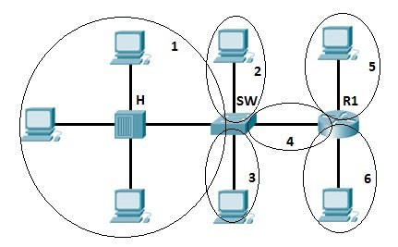
In this figure you can see 6 collision domains highlighted

Slide 15
Broadcast Domain
A broadcast domain is the domain in which a broadcast is forwarded. A broadcast domain contains all devices that can reach each other at the data link layer (OSI layer 2) by using broadcast. All ports on a hub or a switch are by default in the same broadcast domain. All ports on a router are in the different broadcast domains and routers don’t forward broadcasts from one broadcast domain to another.

Slide 16
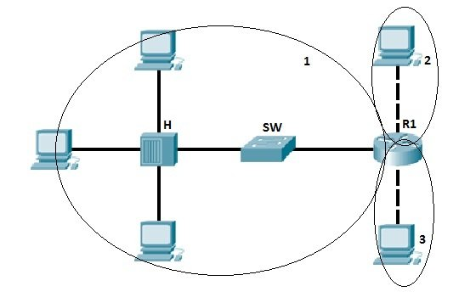
In the picture above we have three broadcast domains, since all ports on a hub or a switch are in the same broadcast domain, and all ports on a router are in a different broadcast domain.

Slide 17
Issues
As the number of devices in the Broadcast Domain increases, number of Broadcasts also increases and the quality of the network will come down because of the following reasons.
Decrease in available Bandwidth: Large number of Broadcasts will reduce the available bandwidth of network links for normal traffic because the broadcast traffic is forwarded to all the ports in a switch.
Decrease in processing power of computers: Since the computers need to process all the broadcast packets it recieve, a portion of the computer CPU power is spent on processing the broadcast packets.

Slide 18
Why VLAN ?
A VLAN shares similar characteristics to a LAN, but a VLAN allows different computers and devices to be connected virtually to each other as if they were in a LAN sharing a single broadcast domain. In a way, a VLAN acts mini separate networks within a LAN. A VLAN is helpful for organizational use mainly because it can be used to segment a larger network into smaller segments. As shown in the figure below, different VLANs can be used for different groups of users, departments, functions, etc., without needing to be in the same geographical area.

Slide 19
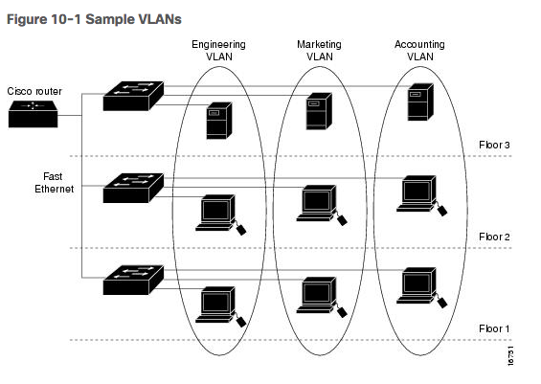
Segmentation of a network helps to increase security, reliability, and efficiency of a network. There are a variety of ways a VLAN can be utilized to fit an organization’s needs.

Slide 20
A VLAN allows different computers and devices to be connected virtually to each other as if they were in a LAN sharing a single broadcast domain.
A VLAN is helpful for organizational use mainly because it can be used to segment a larger network into smaller segments.
VLANs can limit user access to a certain VLAN, which then allows only authorized users to have access to networks with highly sensitive information.
VLANs can be used for different groups of users, departments, functions, etc., without needing to be in the same geographical area.
VLANs can help reduce IT cost, improve network security and performance, provide easier management, as well as ensuring network flexibility.

Slide 21
Points to ponder…
Why not create a large subnet instead of smaller VLANs or LANs? A single subnet is simple to understand and implement but creates problems as the network grows. By creating smaller subnets, this limits the broadcast domain traffic. Think of broadcast traffic as one device making an announcement to the rest of the devices in the network like a person speaking to a large audience, but in networking every device can speak at the same time.

Slide 22
Scenario for VLANs

Slide 45
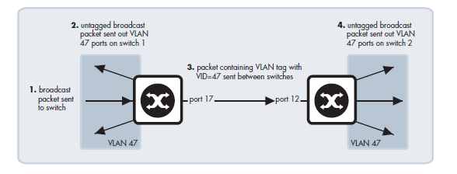
VLAN implementation
Port Based VLAN
Ports of switch are simply assigned to VLANs, with no extra criteria.

Slide 46
Types of VLAN
Port-Based VLAN
Port-based VLANs groups virtual local area network by port. In this type of virtual LAN, a switch port can be configured manually to a member of VLAN.
Devices that are connected to this port will belong to the same broadcast domain that is because all other ports are configured with a similar VLAN number.
The challenge of this type of network is to know which ports are appropriate to each VLAN. The VLAN membership can’t be known just by looking at the physical port of a switch. You can determine it by checking the configuration information.

Slide 47
Protocol Based VLAN
This type of VLAN processes traffic based on a protocol that can be used to define filtering criteria for tags, which are untagged packets.
In this Virtual Local Area Network, the layer-3 protocol is carried by the frame to determine VLAN membership. It works in multi-protocol environments. This method is not practical in a predominately IP based network.

Slide 48
MAC Based VLAN
MAC Based VLAN allows incoming untagged packets to be assigned virtual LAN and, thereby, classify traffic depending on the packet source address. You define a Mac address to VLAN mapping by configuring mapping the entry in MAC to the VLAN table.

Slide 49
Advantages of VLAN
Performance.
Formation of virtual Workgroups.
Flexibility.
Ease of partitioning of resources.

Slide 50
Storages
Computer memory and local storage might not provide enough storage, storage protection, multiple-user access, or speed and performance for enterprise applications. So, most organizations employ some form of a SAN in addition to network-attached storage (NAS) for improved efficiency and better data management.

Slide 51
Storage Area Network
A storage area network is a dedicated, high-performance storage system that transfers block-level data between servers and storage devices. SAN is typically used in data centers, enterprises or virtual computing environments. It offers the speed of DAS with the sharing, flexibility and reliability of NAS. SAN storage is a very sophisticated option that’s meant to support complex, mission-critical applications.

Slide 52
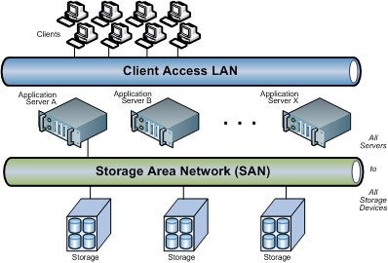

Slide 53
Best Use Case Scenario: SAN is best for block-level data sharing of mission- critical files or applications at data centers or large-scale enterprise organizations.
Worst Use Case Scenario: SAN can be a significant investment and is a sophisticated solution that’s typically reserved for serious large-scale computing needs. A small-to-midsize organization with a limited budget and few IT staff or resources likely wouldn’t need SAN.

Slide 54
Why storage area networks are important
SAN introduces networking flexibility enabling one server, or many heterogeneous servers across multiple data centers, to share a common storage utility. The SAN also eliminates the traditional dedicated connection between a file server and storage—and the concept that the server effectively owns and manages the storage devices—eliminating bandwidth bottlenecks.

Slide 55
Advantages of SAN
Improved application availability Storage exists independently of applications, and it's accessible through multiple paths for increased reliability, availability and serviceability.
Better application performance SANs offload and move storage processing from servers onto separate networks.

Slide 56
Central and consolidated SANs make simpler management, scalability, flexibility and availability possible.
Remote site data transfer and vaulting SANs protect data from disaster and malicious attacks with a remote copy.
Simple centralized management SANs simplify management by creating single images of storage media.

Slide 57
Virtual SAN
A virtual storage area network (SAN) is a software-based component that provides a virtualized ‘pool’ of storage to multiple virtual machines (VMs) and applications. In order to achieve this, data is passed (shared) between servers over a network using a protocol such as iSCSI or fibre channel.

Slide 58
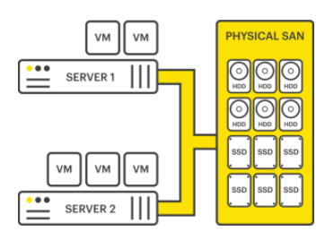
A virtual SAN enables organizations to eliminate the dedicated storage hardware and associated networking within their physical infrastructure.

Slide 59
Instead, the virtual SAN is installed on commodity x86 servers, often (but not always) the same servers that generally handle the organization’s compute functionality.
A virtual SAN converges traditional datacenter hardware components into a single virtualized appliance, controlled by a software layer. It can either be installed as a software program that runs on a virtual machine (VM), or be incorporated into a storage vendor's firmware and sold as a single, consolidated solution.

